Slide 1
Computational Physics
Unit 4
Kinematics of interconnected rigid bodies– Definition of a linkage – Definition of a mechanism –Four-bar mechanism.

Slide 2
Kinematics of interconnected rigid bodies
A rigid body is an idealized object in mechanics in which the distances between all points within the body remain fixed. This means that the body does not deform or change shape, even when forces or moments are applied to it
Interconnected Rigid Bodies:
These are two or more rigid bodies connected by joints or other mechanical elements, such that the motion of one body influences the motion of the others.
The connections (or joints) constrain the relative motion between the bodies, meaning the movement of one body affects the positions and motions of the others within the system.

Slide 3
Definition of a linkage
A linkage is a mechanical system consisting of multiple rigid bodies (called links) connected by joints. These connections allow the transfer of motion or force between the links, and the primary purpose of a linkage is to transform or control the motion of one part in relation to another.
Links are individual parts of the mechanisms. They are rigid bodies and are connected with other links to transmit motion and forces.
Joint is a movable connection between links and allows relative motion between links.

Slide 4
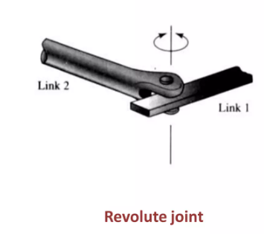
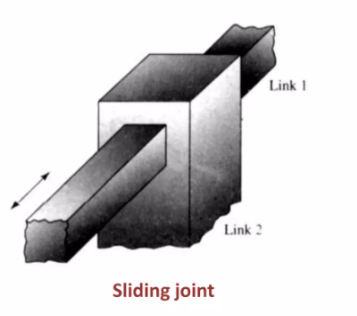
Joints can be of different types, including:
1. Revolute joints (which allow rotational motion)
2. Prismatic joints/Sliding joint (which allow sliding motion)

Slide 5
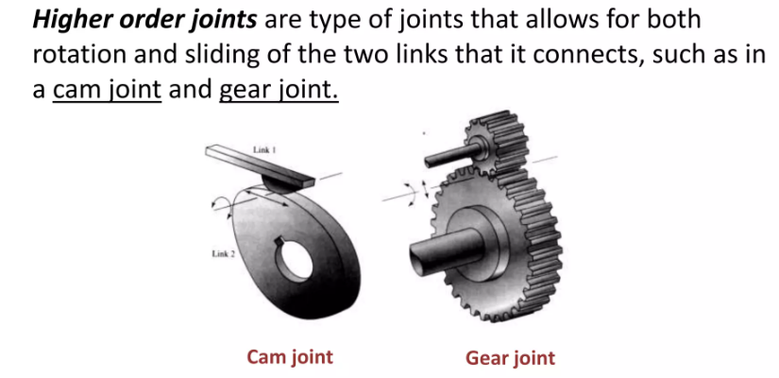
3. Higher order joints (e.g., gears or cams that allow complex motion)

Slide 6
Types of Linkages:
Open Chain Linkages: These linkages are arranged in a linear sequence, where the last link is not connected back to the first one.
Closed-Loop Linkages: These linkages form a loop, where the last link is connected back to the first link. These are commonly used in mechanisms like engines and gearboxes.

Slide 7

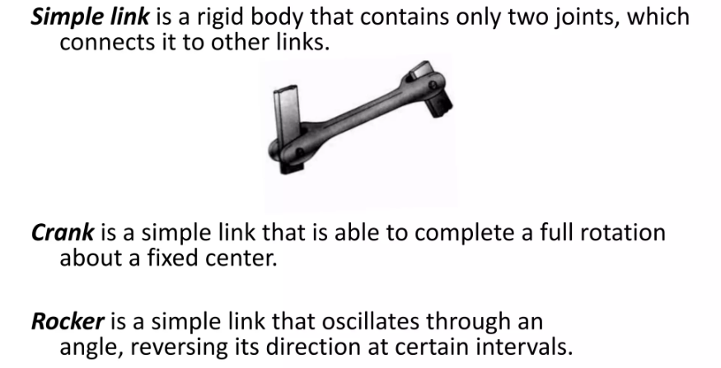

Slide 8

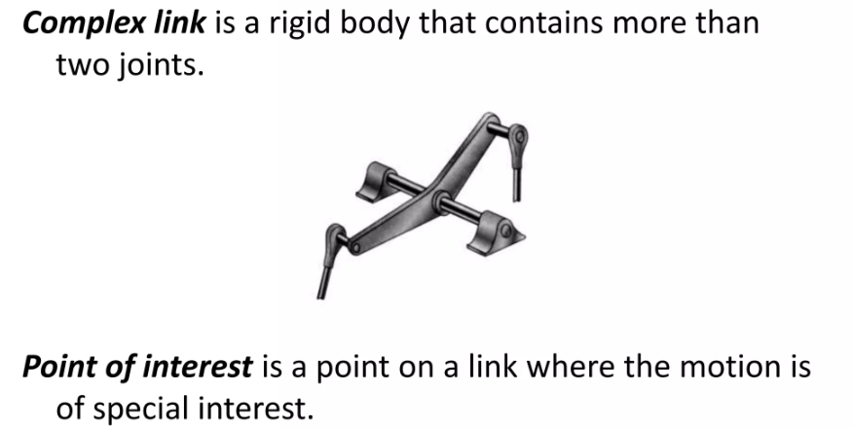

Slide 9
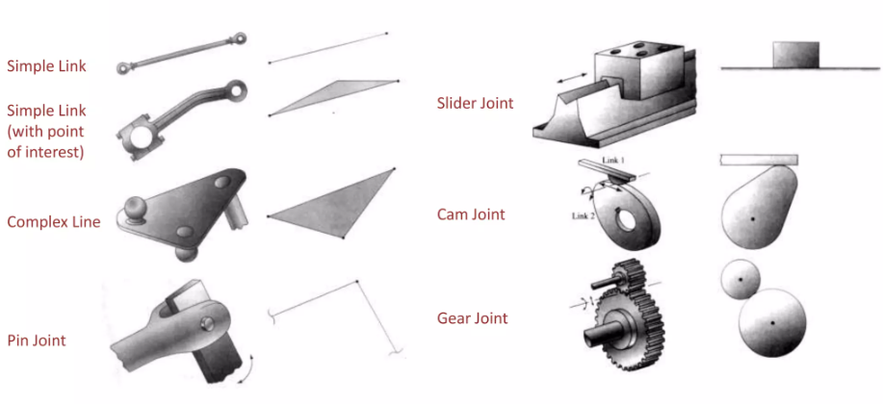

Slide 10
Definition of Mechanism
A mechanism is a mechanical system composed of interconnected rigid bodies (links) that work together to transmit motion and force from one part of the system to another. Mechanisms are designed to perform specific tasks or motions, such as converting one type of motion into another or controlling the movement of parts in machines.
Links: These are the rigid bodies that make up the mechanism.
Joints: The connections between the links, which allow relative motion between the links. These can be revolute (rotational), prismatic (linear), or other types of joints.

Slide 11
Planar vs. Spatial Mechanisms
Planar Mechanisms:
When all the links of a mechanism have plane motion, it is called as a planar mechanism. All the links in a planar mechanism move in planes parallel to the reference plane.
Spatial Mechanisms:
A mechanisms where links move in 3 dimensions.

Slide 12
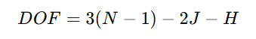
Degree of Freedom (DOF) in Mechanisms
The DOF of a mechanism refers to the number of independent inputs (motions) required to fully specify the configuration of the mechanism. It can be calculated using Gruebler’s formula for planar mechanisms:
Where:
N = Number of links
J = Number of joints (connections)
H = Number of higher pairs (e.g., gears or cams)

Slide 13

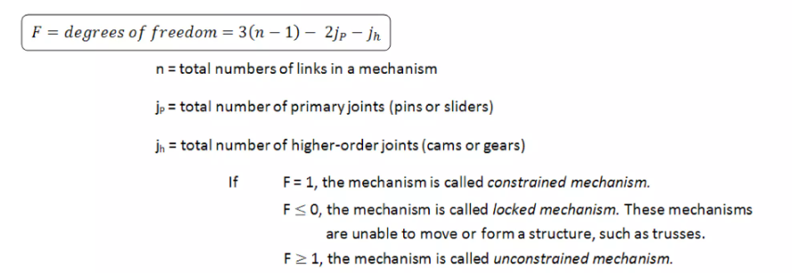

Slide 14
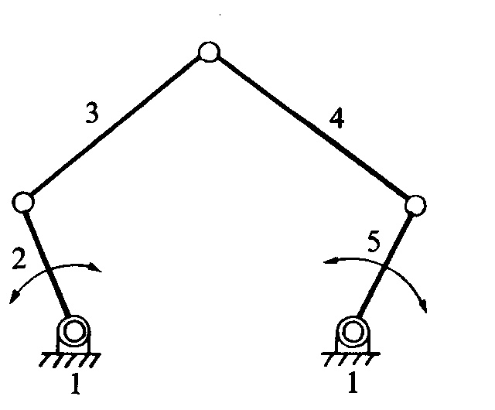
Examples - DOF
F = 3(n-1)-2j-h
Here, n = 5, j = 5 and h = 0.
F = 3(5-1)-2(5) = 2
i.e., two inputs to any two links are required to yield definite motions in all the links.

Slide 15
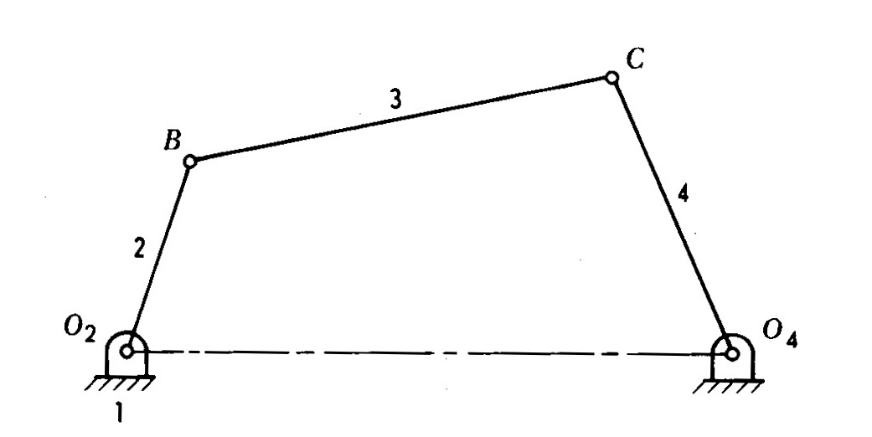
Examples - DOF
F = 3(n-1)-2j-h
Here, n = 4, j = 4 & h = 0.
F = 3(4-1)-2(4) = 1
i.e., one input to any one link will result in definite motion of all the links.

Slide 16
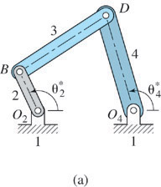
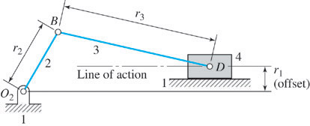
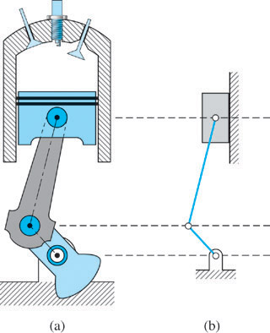
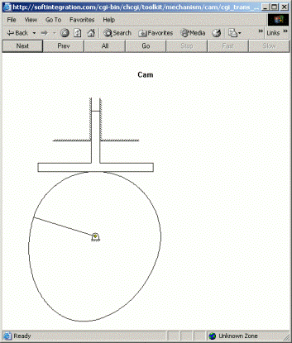
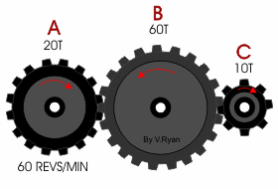
Some Common Types of Mechanisms
4-bar mechanism
5-bar & 6-bar mechanisms
Slider-crank mechanism
Cam-follower mechanism
Gear Trains mechanism
Etc….
slider
Figure. Slider crank mechanism with offset.
Figure. (a) Slider crank mechanism.
(b) Skeleton representation.
crank
Follower
Cam Disk
Figure. Gear train.

Slide 17
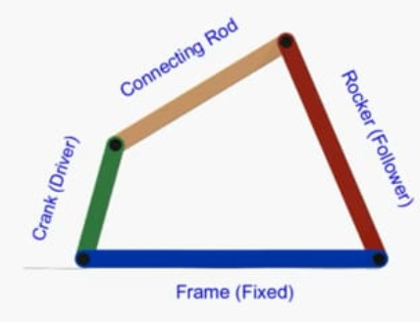
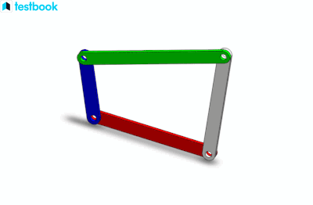
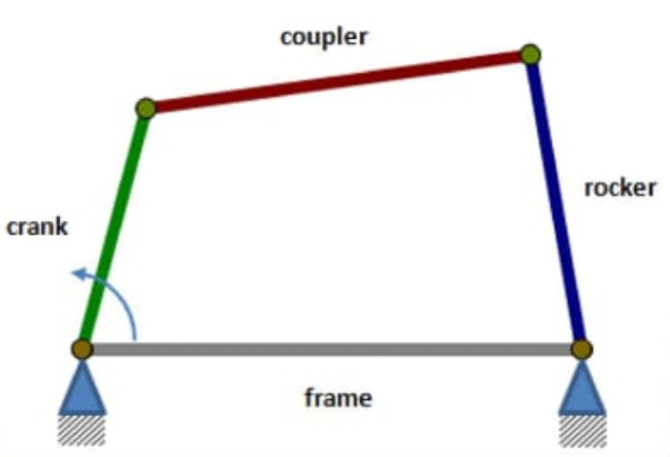
Four-Bar Mechanism
A four-bar mechanism is a type of planar linkage consisting of four links connected in a closed loop. It is one of the most studied and commonly used mechanisms in mechanical design.
Components in a 4-bar mechanism:
It has 4 bars (links)
A stationary or base link and 3 moving links.

Slide 18
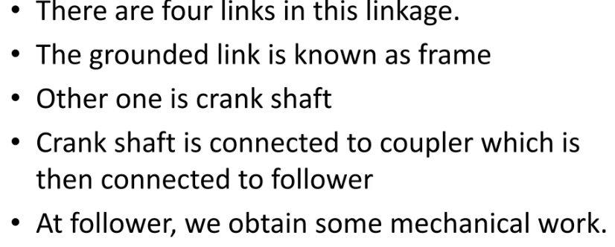
Consider the red bar to be the frame, the grey bar to be the rocker, the green bar to be the connecting rod, and the blue bar to be the crank.
Input Link (Crank): The link that is driven by an external source (such as a motor) and initiates motion in the system.
Output Link (Rocker): The link that performs the desired task or produces the final motion, usually a back-and-forth motion.
Fixed Link (Frame): The stationary part of the system to which the other links are attached.
Coupler Link: The link that connects the input and output links and forms the path of motion.

Slide 19
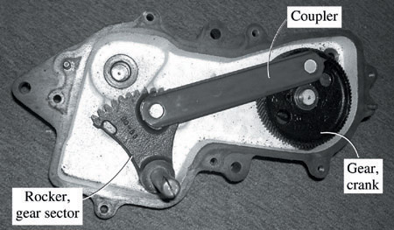
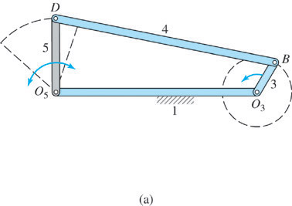
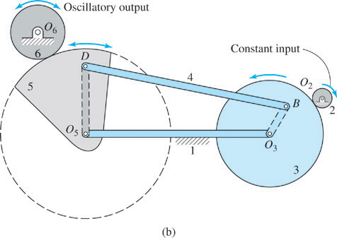
Four-Bar Mechanism
Complex mechanisms can be built from simple mechanisms by adding more links.
FIG. 4-bar mechanism used in a washing machine.
3
4
This gear drives the agitator
to provide the washing action
2
1
Gears
FIG. 4-bar mechanism
Skeleton.
FIG. Complex mechanism

Slide 20
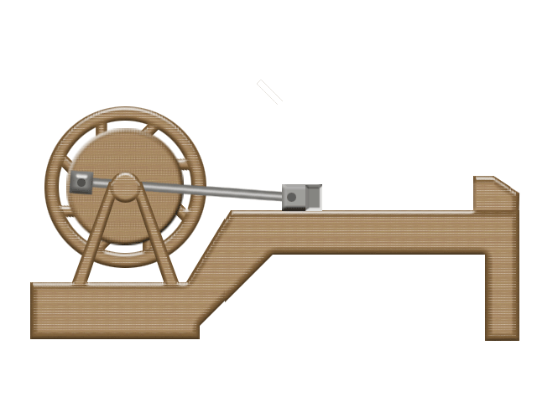
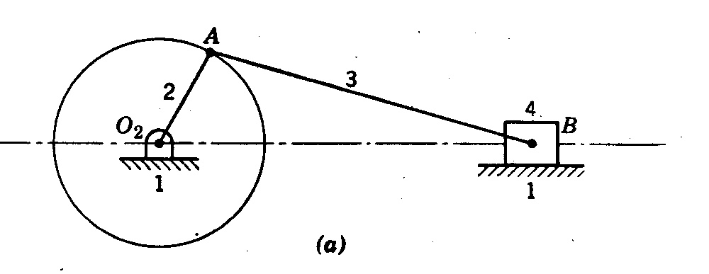
Types of Four-Bar Mechanisms:
Single Slider-Crank Chain Mechanism
3R-IP Mechanism
4- links
3-Turning Pairs
1-slider Pair
3R-1P Mechanism
Link 1 – Fixed Link Link 3 – Connecting Rod
Link 2 – Crank Link 4 – Slider / Piston
If one of four revolute pairs in a four bar kinematic chain is replaced by a prismatic/sliding pair that kinematic chain is called as single slider crank chain.

Slide 21
Types of Four-Bar Mechanisms:
Single Slider-Crank Chain Mechanism
A single slider-crank chain mechanism is a mechanical system consisting of four links, one of which is a sliding link. It is used to convert rotary motion into linear motion or vice versa. It is one of the simplest and most widely used mechanisms in various engineering applications, such as engines and compressors.
Link 1 – Fixed Link Link 3 – Connecting Rod
Link 2 – Crank Link 4 – Slider / Piston

Slide 22
Components:
The single slider-crank mechanism consists of four main components:
Frame (Fixed Link):
This is the stationary link that supports the entire mechanism. It serves as the base for the other moving links.
Crank:
A rotating link connected to the frame that provides input motion. It typically rotates continuously and is driven by an external source such as a motor.
Connecting Rod (Coupler):
A link that connects the crank to the slider. It transmits motion and force between the crank and the slider.
Slider:
A link that moves in a straight line, usually along a guide path. This linear motion is the output of the mechanism.

Slide 23
Link 1 – Fixed Link Link 3 – Connecting Rod
Link 2 – Crank Link 4 – Slider / Piston
Working Principle:
The crank rotates continuously, causing the connecting rod to oscillate.
The oscillatory motion of the connecting rod is converted into the linear motion of the slider.
Alternatively, if the slider is given a linear input motion, the crank can produce a rotary output motion. This is the working principle of the single slider crank mechanism.

Slide 24
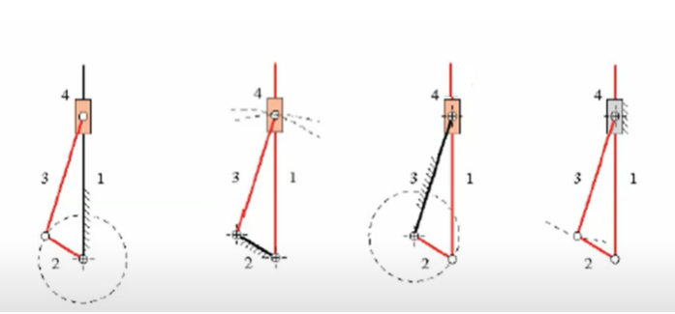
Inversions of Single Slider-Crank Mechanism
The inversion of a mechanism is obtained by fixing a different link in the kinematic chain, while keeping the other links movable. This alters the function and application of the mechanism.
For the single slider-crank mechanism, there are four links, and by fixing each link one at a time, we can obtain four possible inversions. These are used in various machines for different purposes.

Slide 25
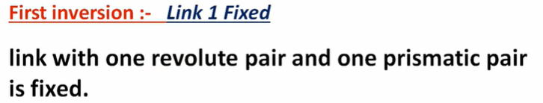
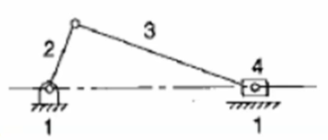
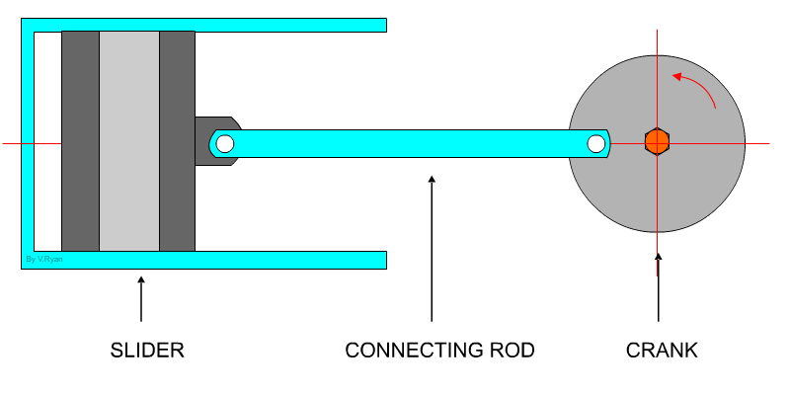
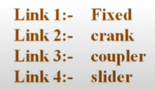
I.C. Engine mechanism.
For the first inversion, the frame (link 1) is fixed, allowing the crank (link 2) to rotate continuously, the connecting rod (link 3) to transmit motion, and the slider (link 4) to reciprocate in a straight line.
Applications
1) I.C. Engine mechanism. (piston driver)
2) In air compressor (crank driver)

Slide 26
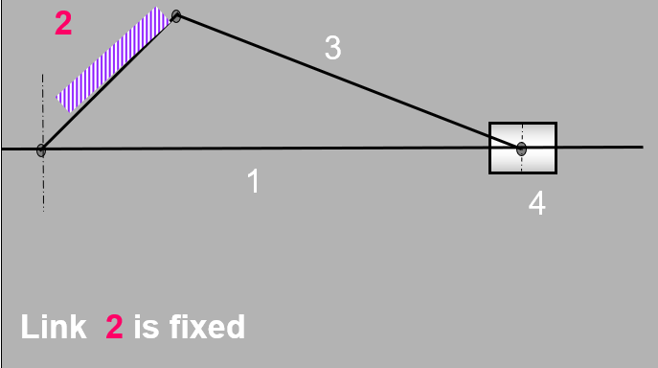
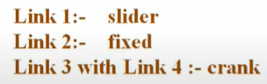
Second Inversion
For the second inversion, the crank (link 2) is fixed, causing the slider (link 4) and the connecting rod (link 3) to work together to produce a quick-return motion, commonly used in shaping and slotting machines.
Rotary engine Mechanism
Whitworth Quick return motion mechanism
Applications

Slide 27
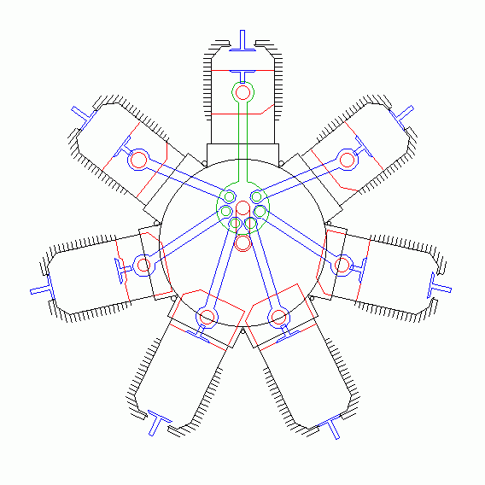
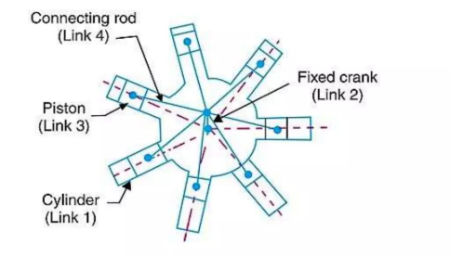
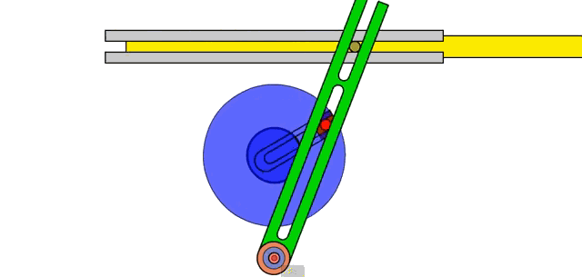
Whitworth Quick return motion mechanism
Rotary engine Mechanism

Slide 28
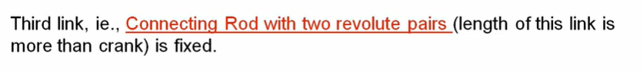
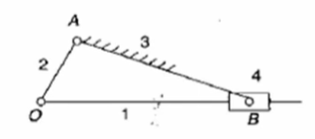
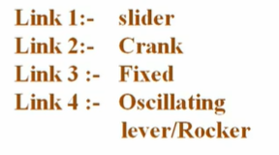
Third Inversion- Link 3 Fixed
Example: 1. Oscillating Cylinder Mechanism
2. Crank and slotted lever quick return
mechanism

Slide 29
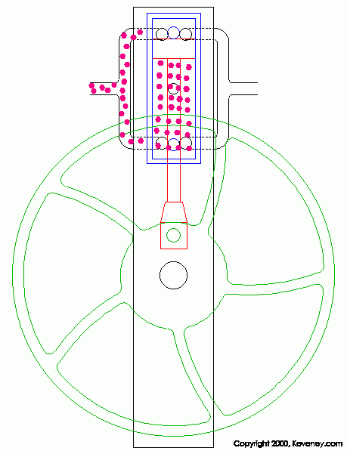
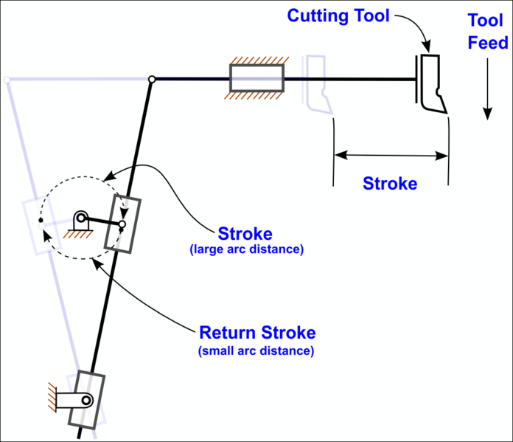
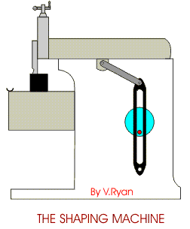
Crank and slotted lever quick return
mechanism
Oscillating Cylinder Mechanism

Slide 30

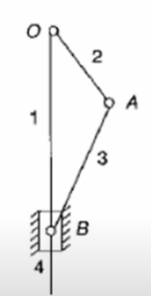
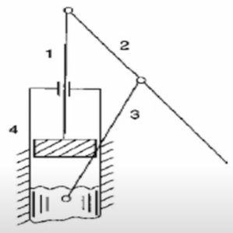
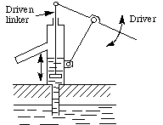
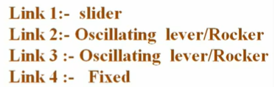
In the original chain, if the fourth link with revolute pair and prismatic pair is fixed, then the fourth inversion is obtained.
Example : Hand Pump

Slide 31
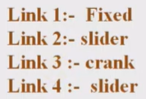
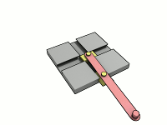
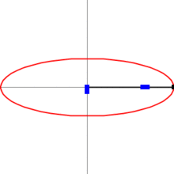
Double Slider Crank Chain
This Chain has two revolute pairs and two prismatic pairs.
The double slider crank chain has three major inversions as follows:
The First inversion of the double slider crank chain is obtained when the link with two prismatic pairs is fixed.
Example : Elliptic Trammel

Slide 32
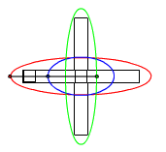

Slide 33
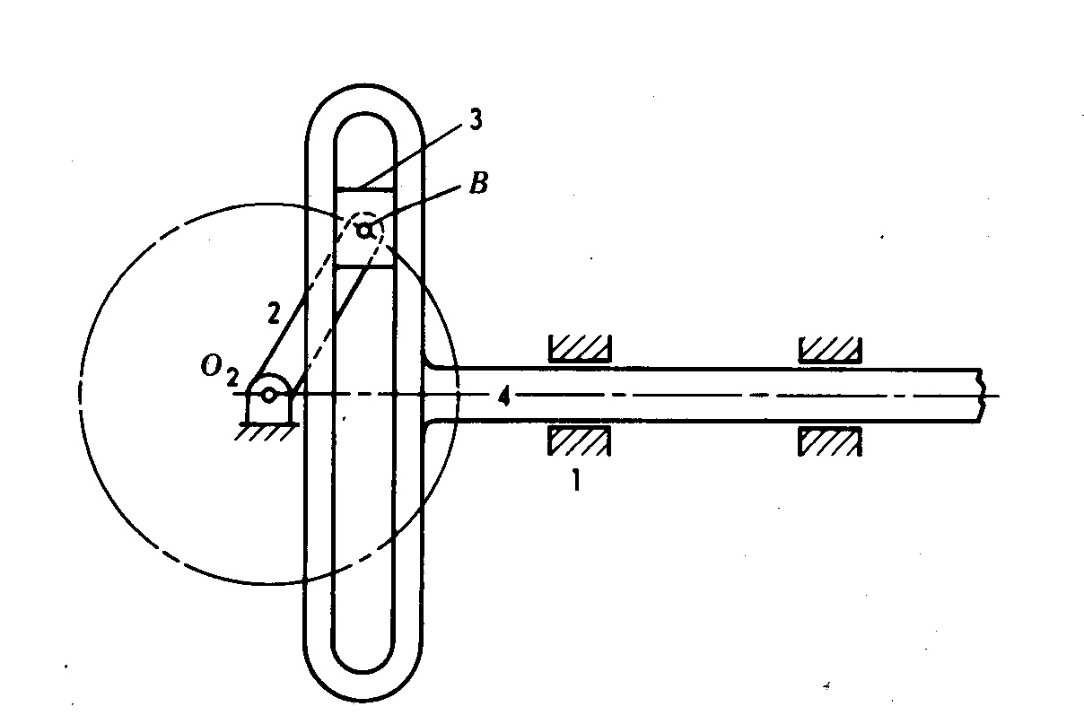
The second inversion is with a link with revolute pair and prismatic pair is fixed.i.e, one slider block is fixed.
Example: Scotch Yoke Mechanism, which is also called as Sinusoidal Generator.
Scotch Yoke Mechanism

Slide 34
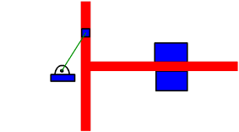

Slide 35

Third inversion of the double slider crank chain is obtained when the link two revolute pairs is fixed.
Example: Oldham coupling, which is used to connect two parallel misaligned shafts.

Slide 36
What is the difference between single and double slider crank mechanism?
The single slider crank mechanism involves only one slider, while the double slider crank mechanism incorporates two sliders for added complexity and motion control.

Slide 37
Double Slider Crank
Feature
Single Slider Crank
Motion Type
Linear or reciprocating motion
Elliptical, sinusoidal, or complex
Lower (one direction)
Higher (two perpendicular sliders)
Degrees of Freedom
Precision
Suitable for simple tasks
Higher precision in special tasks
Applications
Engines, pumps, presses
Elliptical trammel, Scotch yoke, etc.
Smoothness of Motion
Smooth but linear
Smooth with sinusoidal/curved motion
Complexity of Output
Limited
Versatile and complex

Slide 38

Thank You…

